Slide 1
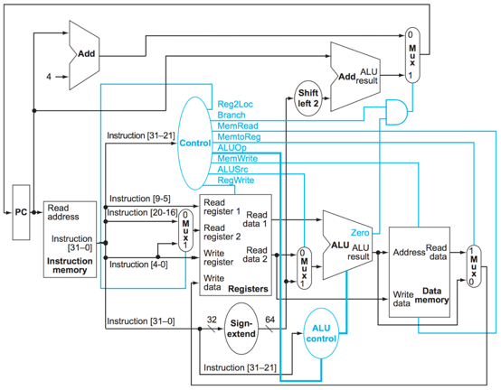
For an ADD instruction, which elements produce output necessary for execution of the instruction?

Slide 2
For an ADD instruction, which elements produce output necessary for execution of the instruction?

Slide 3
For an LDUR instruction, which elements produce output necessary for execution of the instruction?

Slide 4
For an LDUR instruction, which elements produce output necessary for execution of the instruction?

Slide 5
For an CBZ instruction, which elements produce output necessary for execution of the instruction?

Slide 6
For an CBZ instruction, which elements produce output necessary for execution of the instruction?

Slide 7
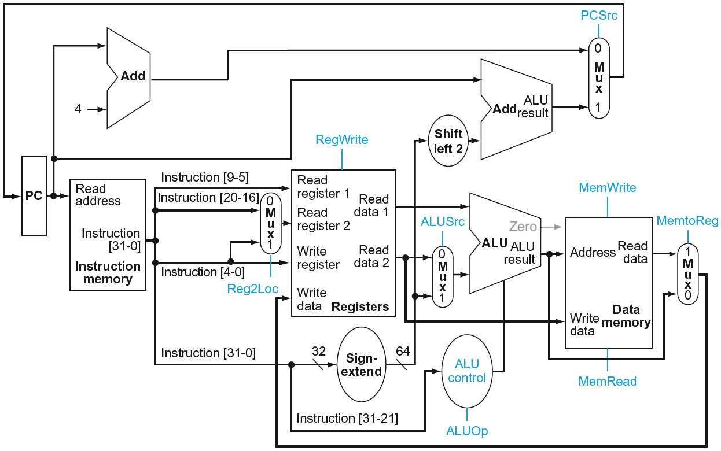
ARM Datapath Control Signals
(© Morgan Kaufmann)
Instruction | Reg2Loc | ALUSrc | MemtoReg | RegWrite | MemRead | MemWrite | Branch | ALUOp1 | ALUOp0
R-Format | 0 | 0 | 0 | 1 | 0 | 0 | 0 | 1 | 0
LDUR | X | 1 | 1 | 1 | 1 | 0 | 0 | 0 | 0
STUR | 1 | 1 | X | 0 | 0 | 1 | 0 | 0 | 0
CBZ | 1 | 0 | X | 0 | 0 | 0 | 1 | 0 | 1

Slide 8
ARM Datapath Control Signals
Wht
What are the values input to the Muxs for an R-format instruction?
(© Morgan Kaufmann)
Instruction | Reg2Loc | ALUSrc | MemtoReg | RegWrite | MemRead | MemWrite | Branch | ALUOp1 | ALUOp0
R-Format | 0 | 0 | 0 | 1 | 0 | 0 | 0 | 1 | 0
LDUR | X | 1 | 1 | 1 | 1 | 0 | 0 | 0 | 0
STUR | 1 | 1 | X | 0 | 0 | 1 | 0 | 0 | 0
CBZ | 1 | 0 | X | 0 | 0 | 0 | 1 | 0 | 1

Slide 9
ARM Datapath Control Signals
Wht
What are the values input to the Muxs for an R-format?
Reg2Loc = 0 register 2 value is in bits 16-20
ALUSrc = 0 second input to ALU is from a register
MemtoReg = 0 data written to a register is output from ALU
(© Morgan Kaufmann)
Instruction | Reg2Loc | ALUSrc | MemtoReg | RegWrite | MemRead | MemWrite | Branch | ALUOp1 | ALUOp0
R-Format | 0 | 0 | 0 | 1 | 0 | 0 | 0 | 1 | 0
LDUR | X | 1 | 1 | 1 | 1 | 0 | 0 | 0 | 0
STUR | 1 | 1 | X | 0 | 0 | 1 | 0 | 0 | 0
CBZ | 1 | 0 | X | 0 | 0 | 0 | 1 | 0 | 1

Slide 10
ARM Datapath Control Signals
W
Which types of instructions write a register?
(© Morgan Kaufmann)
Instruction | Reg2Loc | ALUSrc | MemtoReg | RegWrite | MemRead | MemWrite | Branch | ALUOp1 | ALUOp0
R-Format | 0 | 0 | 0 | 1 | 0 | 0 | 0 | 1 | 0
LDUR | X | 1 | 1 | 1 | 1 | 0 | 0 | 0 | 0
STUR | 1 | 1 | X | 0 | 0 | 1 | 0 | 0 | 0
CBZ | 1 | 0 | X | 0 | 0 | 0 | 1 | 0 | 1

Slide 11
ARM Datapath Control Signals
W
Which types of instructions write a register?
R-format and LDUR have RegWrite = 1
R-format performs an ALU operation and writes the result
LDUR reads from memory and writes it to a register
(© Morgan Kaufmann)
Instruction | Reg2Loc | ALUSrc | MemtoReg | RegWrite | MemRead | MemWrite | Branch | ALUOp1 | ALUOp0
R-Format | 0 | 0 | 0 | 1 | 0 | 0 | 0 | 1 | 0
LDUR | X | 1 | 1 | 1 | 1 | 0 | 0 | 0 | 0
STUR | 1 | 1 | X | 0 | 0 | 1 | 0 | 0 | 0
CBZ | 1 | 0 | X | 0 | 0 | 0 | 1 | 0 | 1

Slide 12
Which instructions access Data memory?

Slide 13
Which instructions access Data memory?
LDUR and STUR

